Slide 1

Using the laws of Gestalt in educational design.
Chelsea Cappetta – EDGE903 – Assignment 4

Slide 2









Visual Design for Education
Why is visual design important for instructional designers?
  The user interface has an impact on the learning experience and the amount of knowledge retained - it has a crucial role in learning (Deubel, 2003)
  According to Gagne’s nine events of instruction, screen design has the initial role of gaining learner attention (Deubel, 2003)
  All interactions in online learning occur through the visual presentation (Wroblewski, 2005)
  It is not just about which multimedia components are used, but also about where these components are placed on the screen (Mott, 2006)
Visual Design vs. Verbal Design
What is Gestalt Psychology?
Why is design so important?
Laws of Gestalt
Principles of Visual Design
Applying Gestalt to design
References

Slide 3



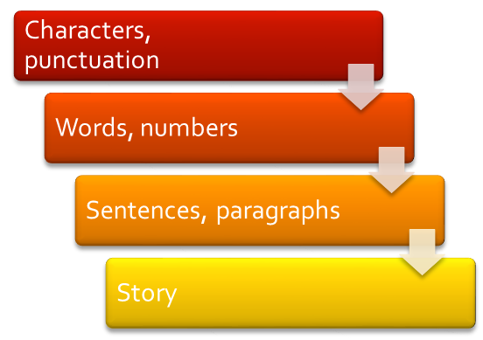
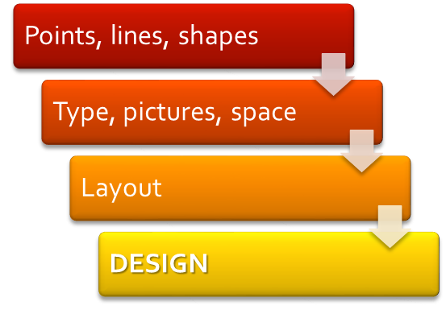
Visual Design for Education
Think about how verbal elements are used in education. There are rules for structuring verbal information – verbal elements such as words are used to form sentences. Visual information can be arranged in much the same way.
Visual Design vs. Verbal Design
What is Gestalt Psychology?
VERBAL
VISUAL
Why is design so important?
Component
Laws of Gestalt
Vocabulary
Principles of Visual Design
Syntax
Message
Applying Gestalt to design
References
Adapted from Schamber, 1986

Slide 4




Visual Design for Education
Gestalt, loosely translated into English, means “shape” or “form
Gestalt psychologists are interested in the way that, within a world of ongoing change and endless variety, people can make sense of so much visual stimuli (Schamber, 1986)
Gestalt theories have implications for education – focussing more on meaningful learning and true understanding of principles, over the traditional structured approaches based on memory and recall (King, Wertheimer, Keller & Crochetiere, 1994)
Visual Design vs. Verbal Design
What is Gestalt Psychology?
Why is design so important?
Laws of Gestalt
Principles of Visual Design
Applying Gestalt to design
References

Slide 5


Visual Design for Education
Gestalt is “not a combination of elements but something new in relation to these, which exists together in their combination, but it distinguishable from it” (Lyons, 2001)
As interface designers we need to recognise that learners will view the concept as a whole – even if it is made up of well-designed parts
How do we create? Imagine?
“Creativity begins [as a] whole....the idea precedes the execution” (Schamber, 1986)
Visual Design vs. Verbal Design
What is Gestalt Psychology?
Why is design so important?
Laws of Gestalt
Principles of Visual Design
Applying Gestalt to design
References

Slide 6



Visual Design for Education
Robins and Holmes (2008) found that a web-page that is aesthetically unappealing and/or poorly designed will produce a negative impression of credibility among its users – regardless of the quality of the information provided.
Gestalt psychology can provide instructional designers with an understanding of “aesthetic perception and cognition” (Lyons, 2001).
Aesthetic design theory provides an avenue for visual analysis – using the laws and principles of Gestalt psychology (Haupt & Blignaut, 2006).
Visual Design vs. Verbal Design
What is Gestalt Psychology?
Why is design so important?
Laws of Gestalt
Principles of Visual Design
Applying Gestalt to design
References

Slide 7










Visual Design for Education
Law of Proximity
  The closer objects are to each other, the more likely they are to be perceived as a group (Ehrenstein, 2004)
Law of Symmetry
  Objects must be balanced or symmetrical to be seen as complete or whole (Chang, 2002).
Visual Design vs. Verbal Design
What is Gestalt Psychology?
Why is design so important?
Laws of Gestalt
Principles of Visual Design
Applying Gestalt to design
References
Gestalt Laws 2

Slide 8





























Visual Design for Education
Law of Similarity
  Objects that are similar, with like components or attributes are more likely to be organised together (Schamber, 1986).
Law of Common Fate
  Objects with a common movement, that move in the same direction, at the same pace , at the same time are organised as a group (Ehrenstein, 2004).
Visual Design vs. Verbal Design
What is Gestalt Psychology?
Objects are viewed in vertical rows because of their similar attributes.
Why is design so important?
Laws of Gestalt
Principles of Visual Design
Applying Gestalt to design
References
Gestalt Laws 3

Slide 9






Visual Design for Education
Law of Continuation
  Objects will be grouped as a whole if they are co-linear, or follow a direction (Chang, 2002; Lyons, 2001).
Law of Isomorphism
  Is similarity that can be behavioural or perceptual, and can be a response based on the viewers previous experiences (Luchins & Luchins, 1999; Chang, 2002). This law is the basis for symbolism (Schamber, 1986).
Visual Design vs. Verbal Design
What is Gestalt Psychology?
Why is design so important?
Laws of Gestalt
Principles of Visual Design
Applying Gestalt to design
References
Gestalt Laws 4

Slide 10
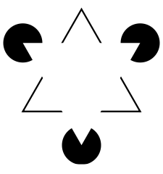
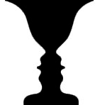
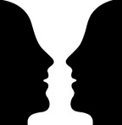

Visual Design for Education
Law of Closure
  In perception there is the tendency to complete unfinished or partially obscured objects (Ehrenstein, 2004). Kanizsa’s triangle (right) is one of the most recognisable examples of this (Wikipedia, 2008).
Law of Figure - Ground
  Viewers will perceive an object (figure) and a surface (ground) even in shapes are grouped together (Ehrenstein, 2004). This law also defines use of contrast (Schamber, 1986).
Visual Design vs. Verbal Design
What is Gestalt Psychology?
Why is design so important?
(Wikipedia, 2008)
Laws of Gestalt
Principles of Visual Design
Applying Gestalt to design
(Chang, 2002)
References
Gestalt Laws 5

Slide 11
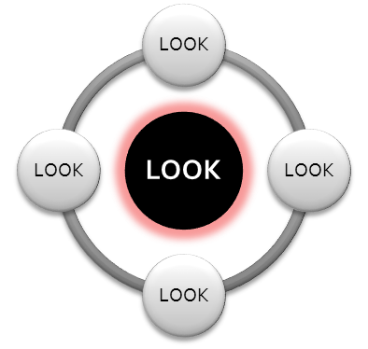
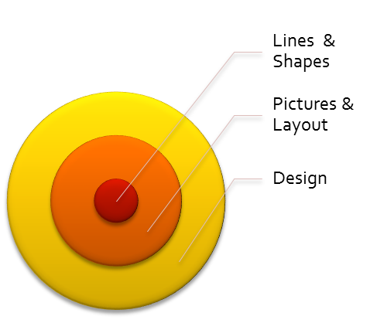

Visual Design for Education
Law of Focal Point
  The idea that a point of interest, something emphasised or different will catch and hold the viewers attention (Chang, 2002).
Law of Simplicity
  This is the law that states that people will visualise according to the simplest way of grouping items – and the effort to simplify complex items is unconscious (Chang, 2002).
Visual Design vs. Verbal Design
What is Gestalt Psychology?
Why is design so important?
Laws of Gestalt
Principles of Visual Design
Applying Gestalt to design
References
Gestalt Laws 6

Slide 12
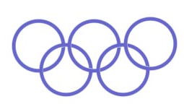

Visual Design for Education
Law of Prägnanz
  Prägnanz means, in simple terms, “good form” and refers to organising shapes to simple forms (Chang, 2002). Figures are seen as their simple elements instead of complicated shapes.
Law of Unity
  Is the law of arrangement, where elements and structures have a visual connection and look like they belong together, in unity (Chang, 2002). Unity is one of the general principles of visual design.
Visual Design vs. Verbal Design
What is Gestalt Psychology?
Why is design so important?
Laws of Gestalt
Principles of Visual Design
Applying Gestalt to design
References

Slide 13

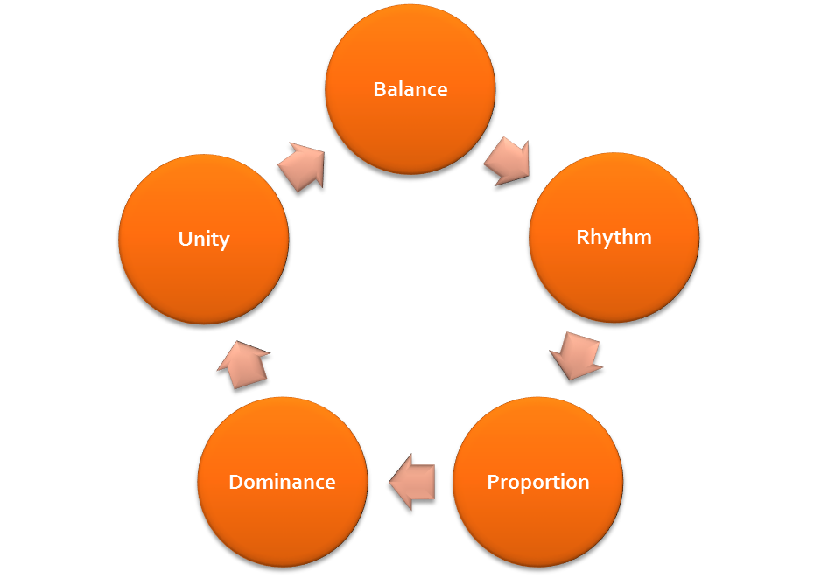

Visual Design for Education
“Design has impact beyond decoration” – Robins & Holmes (2008)
Visual Design vs. Verbal Design
The concept of unity, in particular can be linked to the Gestalt theories of visual perception, and in particular the way the brain categorises and groups visual information (McClurg-Genevese, 2005). Unity describes “the relationship between the individual parts and the whole of the composition” (McClurg-Genevese, 2005). This is perhaps one of the most important aspects of design.
What is Gestalt Psychology?
Why is design so important?
Laws of Gestalt
Principles of Visual Design
Applying Gestalt to design
References

Slide 14



Visual Design for Education
Each of the laws in this presentation provide a technique that can be used in instructional and interface design to maximise visual aesthetics, and therefore maximise learning potential for users.
Don’t forget that just as these Gestalt laws are true when defining human perception, the opposite of each is also true. For example, in the diagram below, the figure on the right is DIS-similar to the others and therefore stands out.
Visual Design vs. Verbal Design
What is Gestalt Psychology?
Why is design so important?
Laws of Gestalt
Principles of Visual Design
Applying Gestalt to design
References
Image from http://graphicdesign.spokanefalls.edu/tutorials/process/gestaltprinciples/gestaltprinc.htm

Slide 15
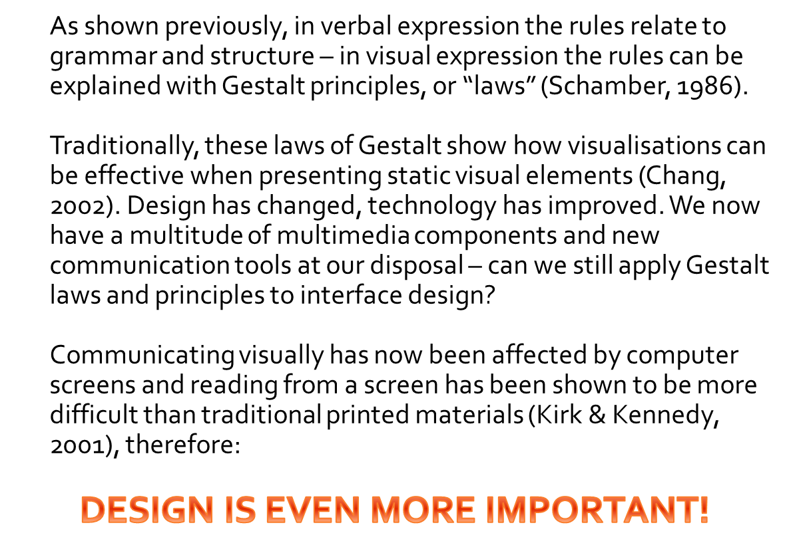
Visual Design for Education
Visual Design vs. Verbal Design
What is Gestalt Psychology?
Why is design so important?
Laws of Gestalt
Principles of Visual Design
Applying Gestalt to design
References

Slide 16


Chang, D., Dooley, L., & Tuovinen, J. E. (2002). Gestalt Theory in Visual Screen Design – A New Look at an Old Subject. Paper presented at 7th World Conference on Computers in Education, 29th July – 3rd August, Australian Computer Society, Copenhagen
Deubel, P. (2003). An investigation of behaviorist and cognitive approaches to instructional multimedia design. Journal of Educational Multimedia and Hypermedia, 12(1), pp.63-90
Ehrenstein, W. H. (2004). Perceptual Organization. International Encyclopedia of Social and Behavioural Sciences, pp. 11227-11231
Haupt, G. & Blignaut, S. (2006). Uncovering learning outcomes: explicating obscurity in learning of aesthetics in design and technology education, International Journal of Technology and Design Education, 18(4), pp.361-374
King, D. B., Wertheimer, M., Keller, H., & Crochetiere, K. (1994). The legacy of Max Wertheimer and gestalt psychology (Sixtieth Anniversary, 1934-1994: The Legacy of Our Past). Social Research, 61(4), pp.907
Kirk, J. & Kennedy, G. (2001). Adding Value to Educational Multimedia: The Role of Graphic Design. Proceedings of 18th Annual Conference of Australian Society for Computers in Learning in Tertiary Education (ASCILITE), (pp. 93-96). Melbourne: ASCILITE
Luchins, A.S. & Luchins , E. H. (1999). Isomorphism in Gestalt Theory: Comparison of Wertheimer's and Köhler's Concepts. Retrieved 22 October 2008, from http://gestalttheory.net/archive/luch_iso1.hmtl
Lyons, A. (2001). Gestalt Approaches to the Virtual Gesantkunstwerk. Unpublished Paper. Retrieved 21 October 2008, from http://www.tstex.com
McClurg-Genevese, J. D. (2005). The Principles of Design, in Design in Theory and Practice, Digital Web Magazine, 13 June 2005. Retrieved 10 October 2008, from http://www.digital-web.com/articles/principles_of_design
Mott, R. K. (2006). The Multimedia Design Triangle: An Iterative Development Process. Retrieved 23 August 2008, from http://infohost.nmt.edu/~rkmott/.../multimedia-triangle-ieee-tpc.htm
Robins, D. & Holmes, J. (2008). Aesthetics and credibility in web site design. Information Processing and Management, 44, pp.386-399
Schamber, L. (1986, August). A Content-Driven Approach to Visual Literacy: Gestalt Rediscovered. Paper presented at 69th Annual Meeting of the Association for Education in Journalism and Mass Communications, Visual Communications Division, Norman, Oklahoma.
Wikipedia. (2008). Kanisza Triangle. Retrieved 23 October 2008, from http://en.wikipedia.org/wiki/Kanizsa_triangle
Wroblewski, L. (2005). Visual Communication Principles for Web Application Interface Design. Retrieved 22 October 2008, from http://www.lukew.com/resources/articles/VCFWAD_April2005.pdf
Visual Design for Education
Visual Design vs. Verbal Design
What is Gestalt Psychology?
Why is design so important?
Laws of Gestalt
Principles of Visual Design
Applying Gestalt to design
References

